Slide 1
Chapter 8: Memory Management

Slide 2
Chapter 8: Memory Management
Background
Swapping
Contiguous Allocation
Paging
Segmentation

Slide 3
Background
Program must be brought into memory and placed within a process for it to be run
Input queue – collection of processes on the disk that are waiting to be brought into memory to run the program
Each process has a separate address space
  Base register: smallest legal physical memory address
  Limit register: size of the range
Memory Background
  Stream of memory address.
  They are used for instruction or data.

Slide 4
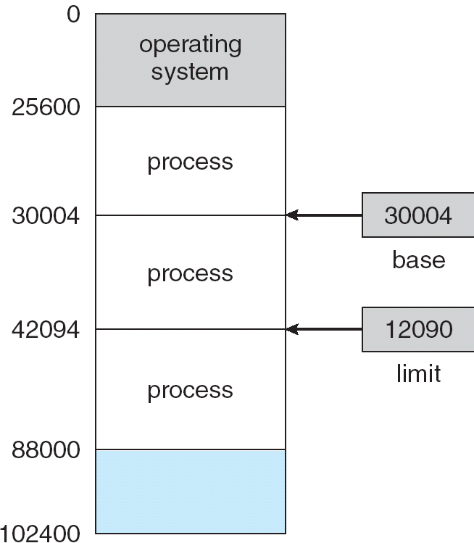
A base and a limit register define a logical address space
If the base register holds 30004 and limit register 12090, the program can legally access all address from 30004 through 42094 (inclusive)

Slide 5

HW address protection with base and limit registers

Slide 6
Binding of Instructions and Data to Memory
Address binding of instructions and data to memory addresses can
happen at three different stages
Compile time: If memory location known a priori, absolute code can be generated; must recompile code if starting location changes
Load time: Must generate relocatable code if memory location is not known at compile time
Execution time: Binding delayed until run time if the process can be moved during its execution from one memory segment to another. Need hardware support for address maps (e.g., base and limit registers).

Slide 7
Logical vs. Physical Address Space
The concept of a logical address space that is bound to a separate physical address space is central to proper memory management
  Logical address – generated by the CPU; also referred to as virtual address
  Physical address – address seen by the memory unit
Logical and physical addresses are the same in compile-time and load-time address-binding schemes;
logical (virtual) and physical addresses differ in execution-time address-binding scheme
Notes:
??

Slide 8
Memory-Management Unit (MMU)
Hardware device that maps virtual to physical address
In MMU scheme, the value in the relocation register is added to every address generated by a user process at the time it is sent to memory
The user program deals with logical addresses; it never sees the real physical addresses

Slide 9

Dynamic relocation using a relocation register

Slide 10
Swapping
A process can be swapped temporarily out of memory to a backing store, and then brought back into memory for continued execution
Backing store – fast disk large enough to accommodate copies of all memory images for all users; must provide direct access to these memory images
Roll out, roll in – swapping variant used for priority-based scheduling algorithms; lower-priority process is swapped out so higher-priority process can be loaded and executed
Major part of swap time is transfer time; total transfer time is directly proportional to the amount of memory swapped
Modified versions of swapping are found on many systems (i.e., UNIX, Linux, and Windows)

Slide 11

Schematic View of Swapping

Slide 12
Contiguous Allocation
Main memory usually into two partitions:
  Resident operating system, usually held in low memory with interrupt vector
  User processes then held in high memory
Memory mapping and protection
  Relocation-register scheme used to protect user processes from each other, and from changing operating-system code and data
  Relocation register contains value of smallest physical address
  Limit register contains range of logical addresses – each logical address must be less than the limit register

Slide 13
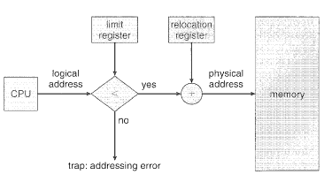
Relocation and Limit registers

Slide 14
Contiguous Allocation (Cont.)
Multiple-partition allocation
  Hole – block of available memory; holes of various size are scattered throughout memory
  When a process arrives, it is allocated memory from a hole large enough to accommodate it
  Operating system maintains information about:
  a) allocated partitions b) free partitions (hole)
OS
OS
OS
OS
process 5
process 5
process 5
process 5
process 9
process 9
process 8
process 10
process 2
process 2
process 2
process 2

Slide 15
Dynamic Storage-Allocation Problem
How to satisfy a request of size n from a list of free holes
First-fit: Allocate the first hole that is big enough
Best-fit: Allocate the smallest hole that is big enough; must search entire list, unless ordered by size. Produces the smallest leftover hole.
Worst-fit: Allocate the largest hole; must also search entire list. Produces the largest leftover hole.
First-fit and best-fit better than worst-fit in terms of speed and storage utilization

Slide 16
Given memory partitions of 200k, 250k,250k,200k, 320k, and 600k (in order, bottom to top), apply first fit, worst fit and best fit algorithms to place processes with the space requirement of 240k, 425k, 112k and 426k (in order). Which algorithm makes the most effective use of memory?

Slide 17
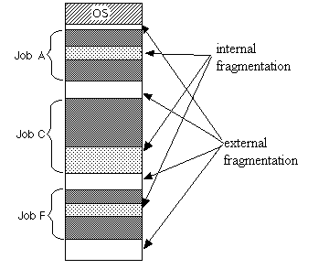
Fragmentation
External Fragmentation – total memory space exists to satisfy a request, but it is not contiguous
Internal Fragmentation – allocated memory may be slightly larger than requested memory; this size difference is memory internal to a partition, but not being used
Reduce external fragmentation by compaction
  Shuffle memory contents to
  place all free memory together
  in one large block
  Compaction is possible only
  if relocation is dynamic, and
  is done at execution time
  I/O overhead

Slide 18
Paging
Logical address space of a process can be non-contiguous; process is allocated physical memory whenever the latter is available
Divide physical memory into fixed-sized blocks called frames (size is power of 2, between 512 bytes and 8192 bytes)
Divide logical memory into blocks of same size called pages.
Keep track of all free frames
To run a program of size n pages, need to find n free frames and load program
Set up a page table to translate logical to physical addresses
Internal fragmentation

Slide 19
Address Translation Scheme
Address generated by CPU is divided into:
  Page number (p) – used as an index into a page table which contains base address of each page in physical memory
  Page offset (d) – combined with base address to define the physical memory address that is sent to the memory unit

Slide 20
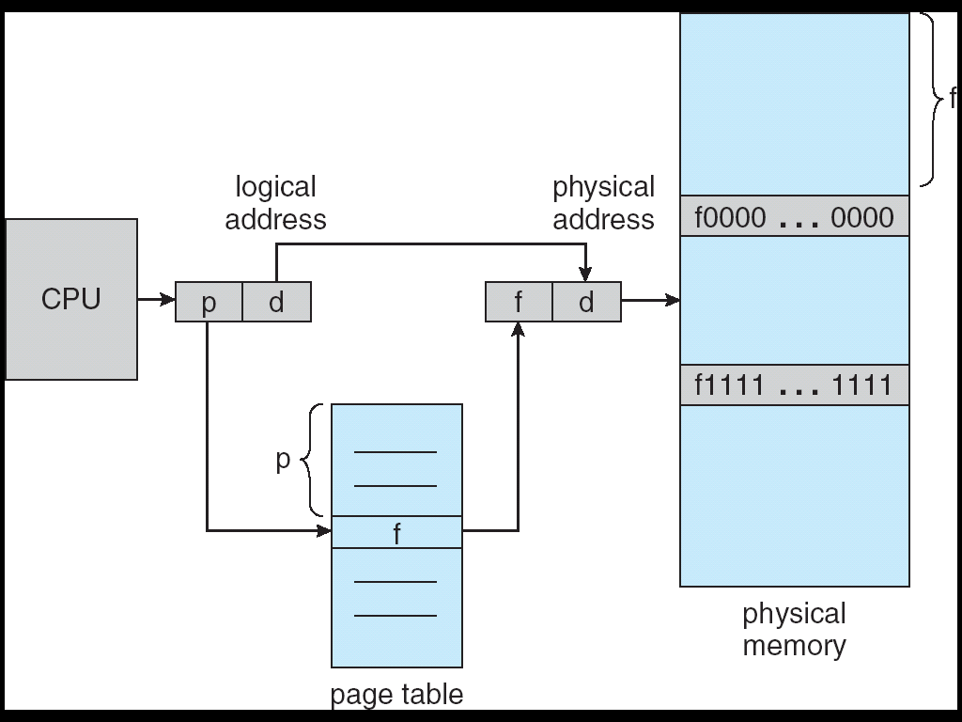
Address Translation Architecture

Slide 21

Paging Example

Slide 22

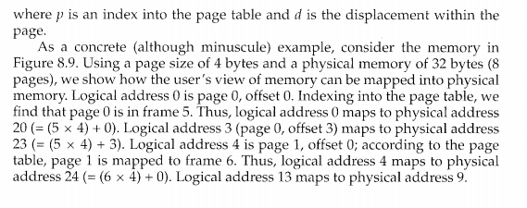
Paging Example

Slide 23

Free Frames
Before allocation
After allocation

Slide 24
Memory Protection
Memory protection implemented by associating protection bit with each frame
Valid-invalid bit attached to each entry in the page table:
  “valid” indicates that the associated page is in the process’ logical address space, and is thus a legal page
  “invalid” indicates that the page is not in the process’ logical address space

Slide 25

Valid (v) or Invalid (i) Bit In A Page Table

Slide 26
Shared Pages
Shared code
  One copy of read-only (reentrant) code shared among processes (i.e., text editors, compilers, window systems).
  Shared code must appear in same location in the logical address space of all processes
Private code and data
  Each process keeps a separate copy of the code and data
  The pages for the private code and data can appear anywhere in the logical address space

Slide 27
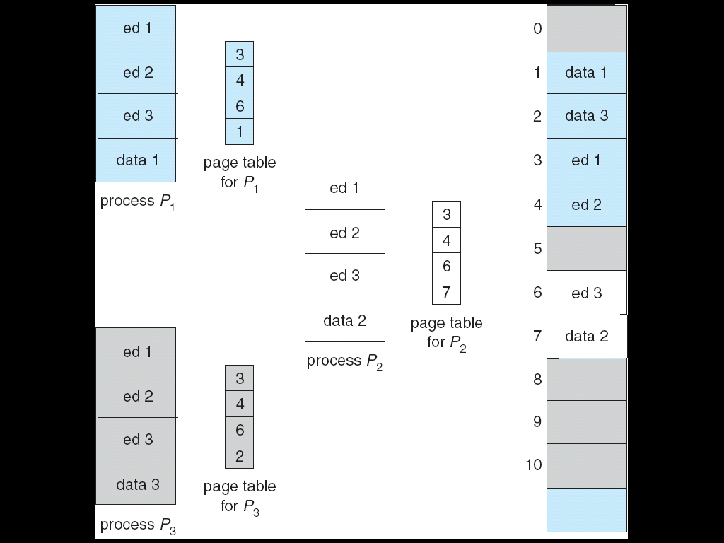
Shared Pages Example

Slide 28
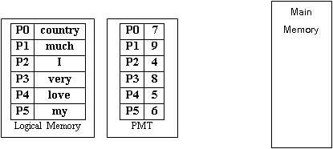
Assume that page size = 2 bytes and Physical Memory = 34 bytes. If CPU generates logical addresses 5, 3, 9, 0, 11 and 7 respectively then how the users’ view of memory can be mapped into physical memory?

Slide 29
Segmentation
Memory-management scheme that supports user view of memory
A program is a collection of segments. A segment is a logical unit such as:
main program,
procedure,
function,
method,
object,
local variables, global variables,
common block,
stack,
symbol table, arrays

Slide 30

User’s View of a Program

Slide 31
Logical View of Segmentation
1
1
4
2
3
4
2
3
user space
physical memory space

Slide 32
Segmentation Architecture
Logical address consists of a two tuple:
<segment-number, offset>,
Segment table – maps two-dimensional physical addresses; each table entry has:
  base – contains the starting physical address where the segments reside in memory
  limit – specifies the length of the segment
Segment-table base register (STBR) points to the segment table’s location in memory
Segment-table length register (STLR) indicates number of segments used by a program;
segment number s is legal if s < STLR

Slide 33

Address Translation Architecture

Slide 34

Example of Segmentation

Slide 35
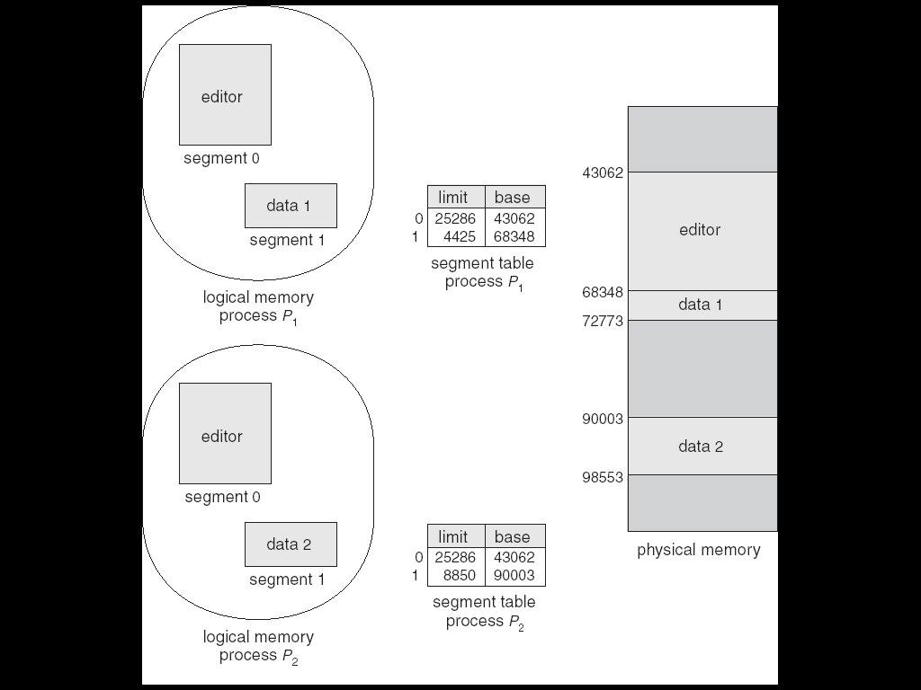
Sharing of Segments

Slide 36
Segmentation Architecture (Cont.)
Protection. With each entry in segment table associate:
  validation bit = 0 ⇒ illegal segment
  read/write/execute privileges
Since segments vary in length, memory allocation is a dynamic storage-allocation problem
Segmentation leads to external fragmentation
Code sharing occurs at segment level; shared segments

Slide 37
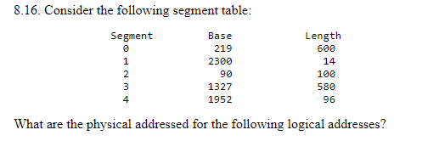
Consider the following segment table:
  (a) 0,430
  (b) 1,10
  (c) 2,500
  (d) 3,400
  (e) 4,112
(a) 219 + 430 = 649
(b) 2300 + 10 = 2310
(c) illegal reference; traps to operating system
(d) 1327 + 400 = 1727
(e) illegal reference; traps to operating system

Slide 38
End of Chapter 8

